Slide 1

Movement and Control of Biomimetic Humanoid Robots
Ben P. Bolen · PhD Defense
November 6, 2026
Notes:
My dissertation makes actuator and transmission assumptions testable, and develops tools for controlled neural–mechanical experiments. Introduce the research robot as the motivating scientific instrument. Advisor: M. Anthony Hunt. Credit the AARL platform and collaborators throughout.
Sources: Portland State University · Agile & Adaptive Robotics Laboratory
robot

Slide 2
Biology offers design principles for unstructured environments
Prepared ground | Unstructured terrain
Wheels exploit a predictable surface | Legs negotiate changing footholds
Efficiency through simple contact | Compliance can store and return energy
Known operating conditions | Feedback must adapt to disturbances
Research goal: useful autonomy beyond prepared surfaces
Ben’s research-goal directive; Dissertation Ch. 1; older Movement and Control talk
2
Notes:
Our first goal is more capable autonomous robots in unstructured environments. Wheels remain efficient on prepared warehouse floors. Sand, forests, and rubble motivate legs, compliant actuation, and sensory neural control. Elastic energy recovery and efficient control are design motivations, not energy savings demonstrated by this dissertation. We therefore need to know whether our chosen biological analogues actually supply the intended capabilities.
Sources: Ben’s research-goal directive; Dissertation Ch. 1; older Movement and Control talk

Slide 3
Biomimetic robots can also test biological hypotheses
Biological mechanisms
Robot experiments
Biomechanics and neuroscience
Controlled changes in mechanics
and sensory pathways
Further application: improved prosthetic and orthotic devices
Ben’s research-goal directive; Dissertation Ch. 1; older Movement and Control talk
3
Notes:
The second goal runs in the other direction. Biological knowledge informs robots, and increasingly biomimetic robots provide experimental access to mechanics and neural pathways. We can change a route or remove a feedback pathway and measure the consequence under repeatable conditions. Such interventions can be impossible or inappropriate in human subjects. Better prosthetic and orthotic devices are a tertiary application of the resulting understanding. The robot must first be characterized well enough that an effect can be interpreted.
Sources: Ben’s research-goal directive; Dissertation Ch. 1; older Movement and Control talk

Slide 4
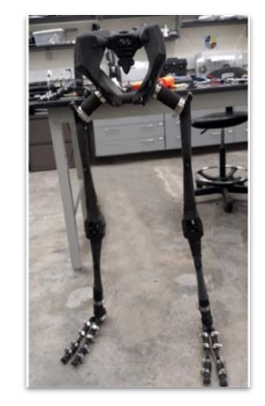
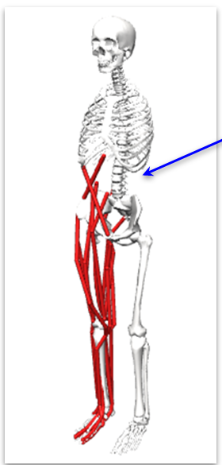
The AARL humanoid is our platform for this research
Skeleton and joints
Artificial muscles
Sensory neural control
Biological inspiration must be checked against measured function
Ben’s research-goal directive; Dissertation Ch. 1; older Movement and Control talk
4
Notes:
This project builds a lower-body humanoid with a printed skeleton, biomimetic joints, and pneumatic artificial muscles. The older talk introduces the physical robot before explaining its modeling requirements; retain that progression. Credit Steele for the four-bar knee, the earlier AARL platform, and Morrow’s route-design collaboration. My dissertation develops force characterization, joint corrections and route tests, SADb, and neural-model tools. The historical photograph and model are the platform introduction, not a claim that all later models are hardware.
Sources: Ben’s research-goal directive; Dissertation Ch. 1; older Movement and Control talk
platform_photo
platform_model

Slide 5
Four knowledge gaps organize this dissertation
Section | Question addressed
1. BPA actuator characterization | How does actuator choice change isometric force?
2. Robot joint design factors | How much force becomes delivered joint torque?
3. SADb | Which sensory evidence informs a pathway choice?
4. SNS tools | How can coupled mechanisms be tested and interpreted?
Ben’s research-goal directive; Dissertation Ch. 1; older Movement and Control talk
5
Notes:
The research goals require four foundations. First, predict artificial-muscle force when actuator length changes. Second, predict what torque the real transmission delivers and compare it with the intended human-muscle target. Third, locate sensory evidence with its experimental context. Fourth, build tools that make coupled circuit behavior testable. These are the four sections of this talk. A general background section is unnecessary; introduce each concept where its question arises.
Sources: Ben’s research-goal directive; Dissertation Ch. 1; older Movement and Control talk

Slide 6

Actuator selection requires force predictions across resting lengths
Design choice: resting length
Measurements: length, pressure,
contraction, and force
537 isometric observations
Question 1: what force can the selected actuator produce?
Bolen et al. (2026), Actuators 15(5):230 · Dissertation Ch. 3
6
Notes:
Begin the first question with the designer’s choice: a human-like leg has limited space, and changing actuator length changes force and excursion. Existing single-length fits and manufacturer predictions did not answer that choice reliably. I characterized 10 and 20 mm BPAs across resting length, pressure, and contraction. The next plots test whether length belongs explicitly in the force model.
Sources: Bolen et al. (2026), Actuators 15(5):230 · Dissertation Ch. 3
jig

Slide 7


Shorter BPAs deliver less maximum isometric force
Resting length changes the force available to a robot design
Bolen et al. (2026), Actuators 15(5):230 · Dissertation Ch. 3
7
Notes:
At 620 kPa, maximum force decreases at short resting lengths in both diameters. The manufacturer tool predicts the opposite trend. Black points are measured data, solid blue is the fitted model, and dashed magenta is the manufacturer prediction. Resting length therefore must be a model input. Do not generalize beyond the tested actuator families.
Sources: Bolen et al. (2026), Actuators 15(5):230 · Dissertation Ch. 3
max10
max20

Slide 8

Resting-length scaling completes the normalized force model
F* normalized force
P* pressure / 620 kPa
ε* normalized contraction
l₀ resting length
Curves: 200–620 kPa
Solid model; circles measured
Dashed manufacturer
Diameter-specific coefficients remain fixed from the published study
Bolen et al. (2026), Actuators 15(5):230 · Dissertation Ch. 3
8
Notes:
The force is the product of a dimensionless force surface and maximum force at the chosen resting length. Normalized pressure and contraction locate the operating point. Separate coefficients apply to each diameter, and maximum contraction is measured for each actuator. The plotted 20 mm curves show measured points and model isoclines. The source uses an 80/20 point split. This does not establish dynamic performance or every unseen actuator length.
Sources: Bolen et al. (2026), Actuators 15(5):230 · Dissertation Ch. 3
forceeq
surface20

Slide 9

A force model must be carried through the joint transmission
Actuator force
Routing and attachment mechanics
Delivered joint torque
Question 2: how much of the available force becomes useful torque?
Dissertation Ch. 4 · Current knee-torque manuscript, §§3–4
9
Notes:
The first contribution makes resting length a quantitative design input. But actuator force alone does not establish joint performance. The force must travel through a route, brackets, and tendons. The next section asks how much torque that assembly actually delivers, how the rigid prediction fails, and which corrections support a better design. This is the handoff from actuator characterization to joint design factors.
Sources: Dissertation Ch. 4 · Current knee-torque manuscript, §§3–4
knee_jig

Slide 10
Joint torque depends on force direction and moment arm
p
F
τz = (r × F) · ẑ
r⊥
r
|τz| = F r⊥
O
Routing also changes
actuator length
A force model needs a transmission model to predict delivered torque
Dissertation Ch. 4 · Current knee-torque manuscript, §§3–4
10
Notes:
Use the editable schematic to explain the cross product. The joint is O, the attachment is p, and the tensile force acts along its route. The perpendicular distance to the force line is the moment arm. Torque magnitude is force times that distance. Routing changes both moment arm and actuator excursion, so maximizing moment arm alone can reduce usable force. The diagram is conceptual and has no numerical geometry.
Sources: Dissertation Ch. 4 · Current knee-torque manuscript, §§3–4

Slide 11
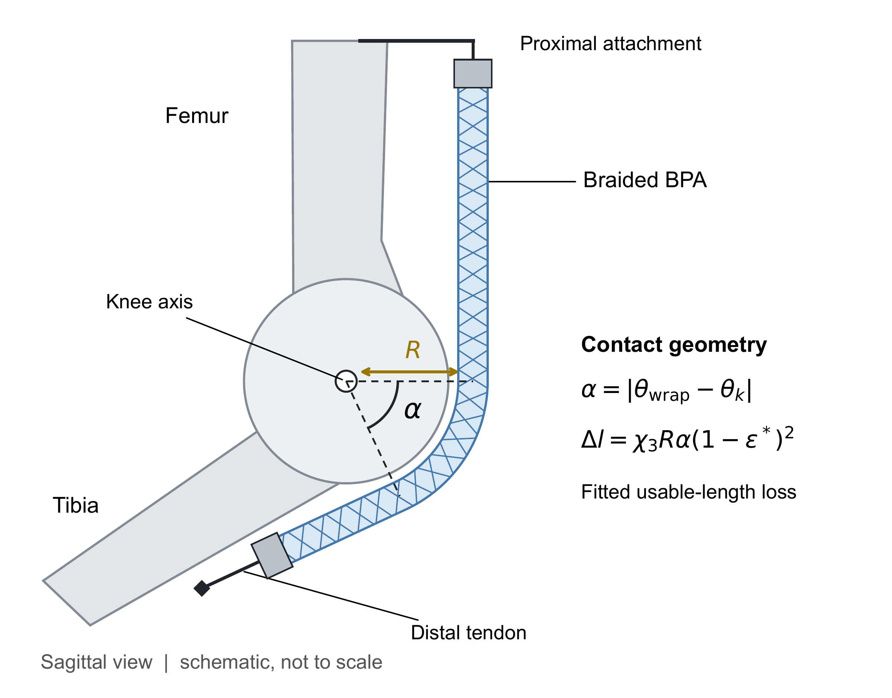

Length, compliance, and wrapping alter usable contraction
Constant offset
Load-dependent deflection
Contact-dependent length loss
The correction terms belong to the actuator–attachment system
Dissertation Ch. 4 · Current knee-torque manuscript, §§3–4
11
Notes:
The model includes a constant length offset, force-dependent displacement in effective attachment frames, and an empirical wrapping loss. χ1 and χ2 describe effective system stiffness, including fixtures and the winch, rather than isolated bracket material stiffness. One pair is shared across flexor and extensor. The wrapping schematic explains contact angle and length loss. Identification uses existing measured tests; route optimization then uses the adopted terms unchanged.
Sources: Dissertation Ch. 4 · Current knee-torque manuscript, §§3–4
wrap
bracket

Slide 12
Corrections reduce error on held-out knee tests
Validation RMSE, N m | No corrections | Corrected
Flexor, 2 tests | 7.588 | 1.490
Extensor, 3 tests | 2.554 | 1.098
Same stiffness pair across both configurations
Tests reserved before evaluating the adopted fit
Dissertation Ch. 4 · Current knee-torque manuscript, §§3–4
12
Notes:
These exact validation means compare the characterized BPA model with all correction terms disabled against the adopted corrected model. Flexor uses two held-out tests, and extensor three. They are the selected folds of the existing identification, not newly collected tests. The same stiffness pair applies to both. One extensor training test retains FVU above one. The claim is lower held-out error, not uniformly accurate fits.
Sources: Dissertation Ch. 4 · Current knee-torque manuscript, §§3–4

Slide 13

The corrected model guides a buildable two-BPA cam route
Two 20 mm BPAs
Cam-assisted tendon path
Adopted transmission
corrections guide the design
The route must satisfy force, excursion, and geometric constraints
Dissertation Ch. 4 · Current knee-torque manuscript, §§3–4
13
Notes:
The extensor redesign uses two 20 mm BPAs. The photo shows the assembled cam-assisted route. The optimizer varies geometry under packaging and torque constraints, using the adopted corrections. Credit Morrow for route-design collaboration and Steele for the underlying four-bar knee. Correction identification and route redesign answer different questions.
Sources: Dissertation Ch. 4 · Current knee-torque manuscript, §§3–4
hardware

Slide 14
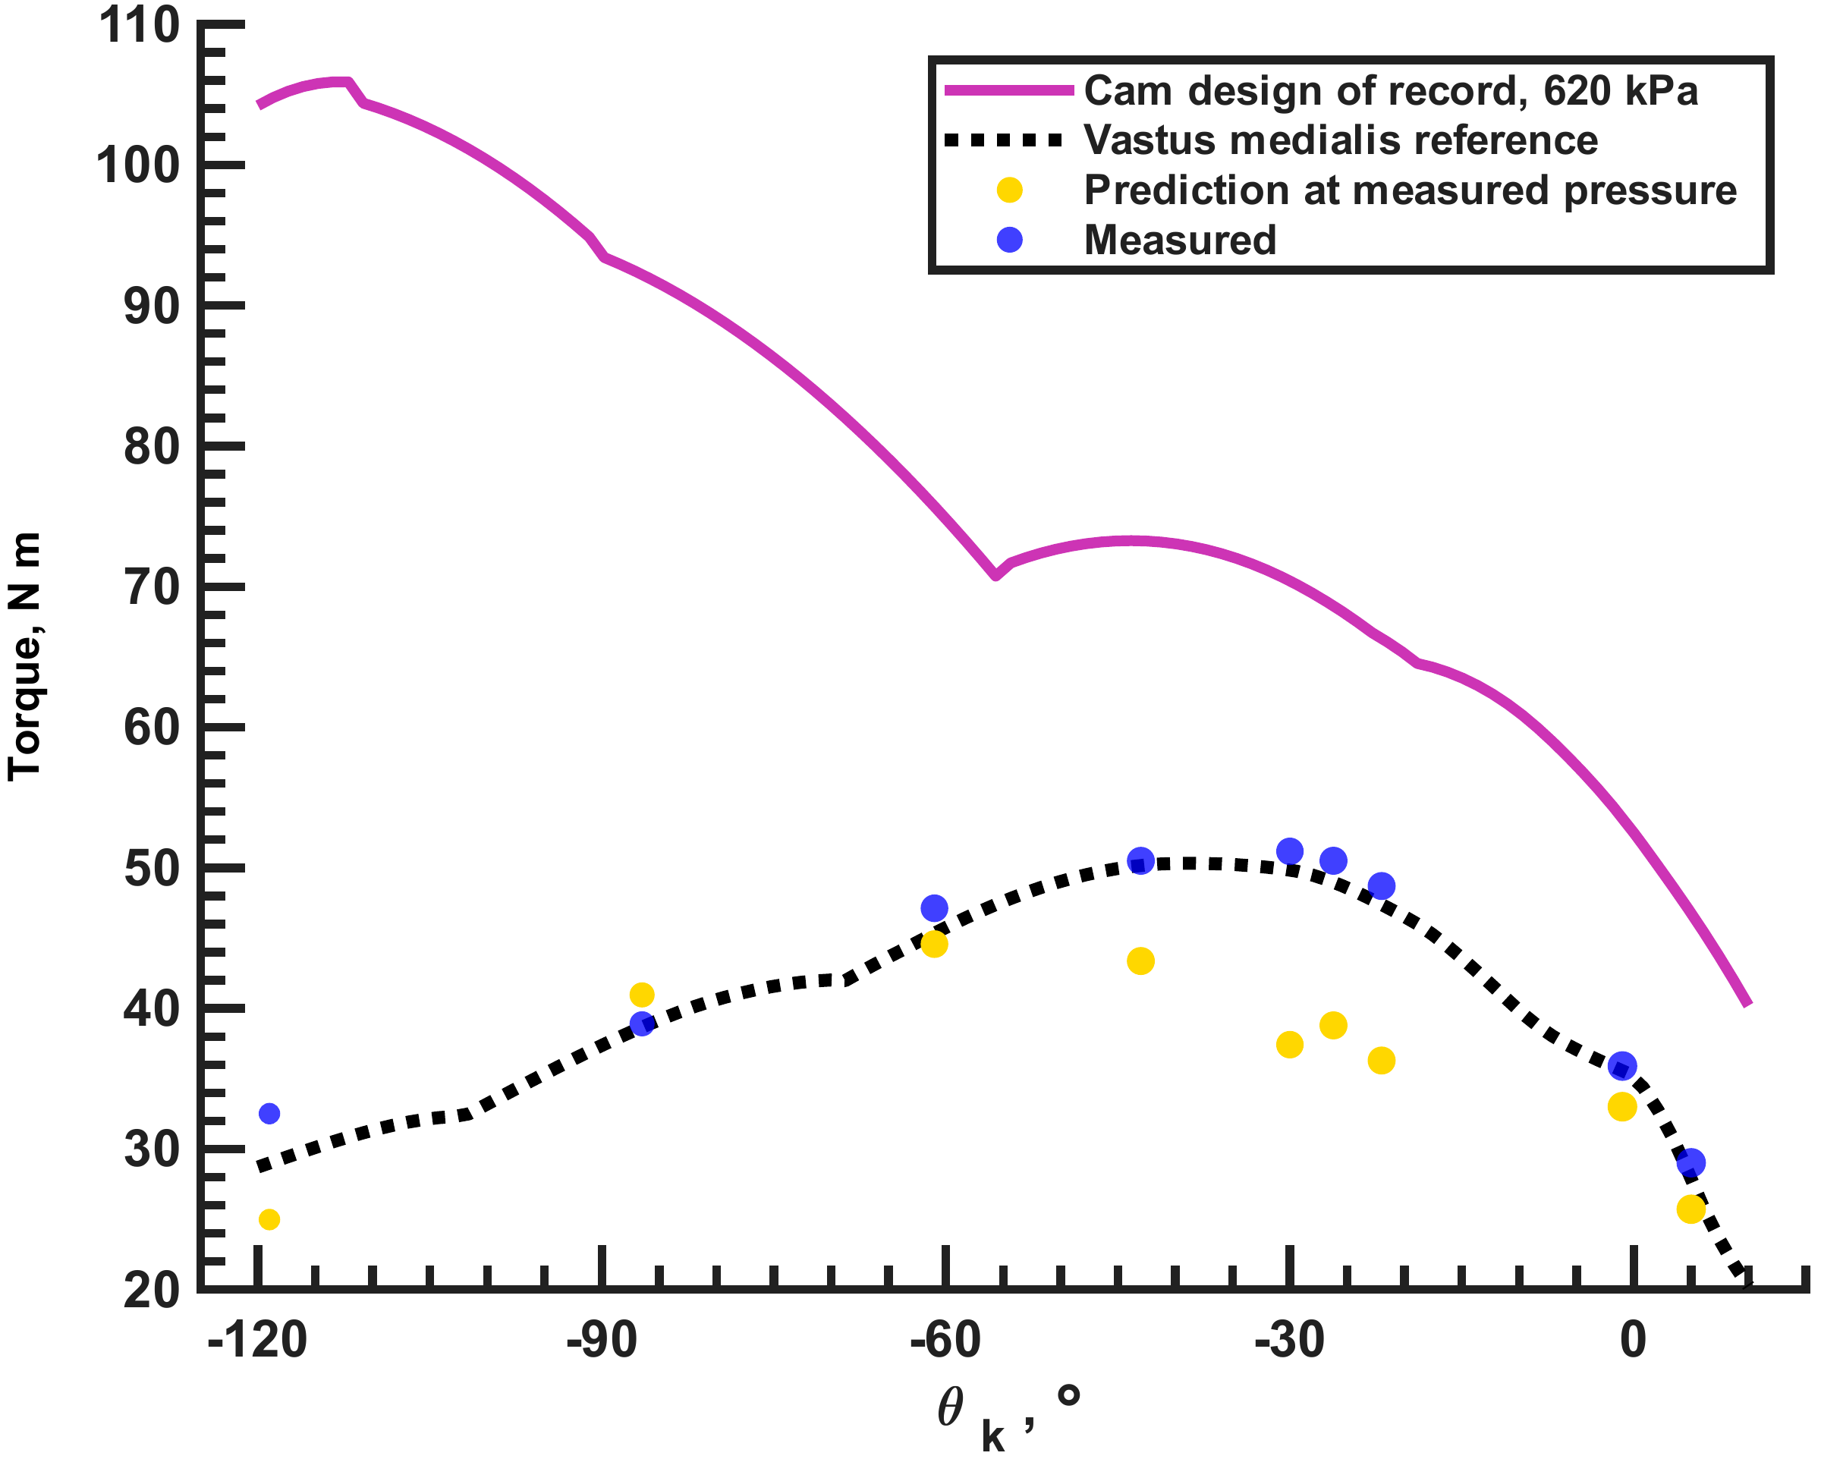
All nine extensor measurements meet the human target
9 of 9 target margins positive · +0.24 to +3.52 N m
Dissertation Ch. 4 · Current knee-torque manuscript, §§3–4
14
Notes:
Read the series identities: blue points are measured, yellow points are predictions at the measured pressures, the dotted black curve is vastus medialis, and magenta is the optimized 620 kPa prediction. All nine measurements exceed the selected human target, including −86.5 degrees. At that angle, the measured torque is 2.06 N m below the pressure-specific prediction. Measured torque is 29.02–51.17 N m; target margins are +0.24 to +3.52 N m at 256–488 kPa. Discrete holds span −119 to +5 degrees. They establish capacity at those configurations.
Sources: Dissertation Ch. 4 · Current knee-torque manuscript, §§3–4
extphysical

Slide 15
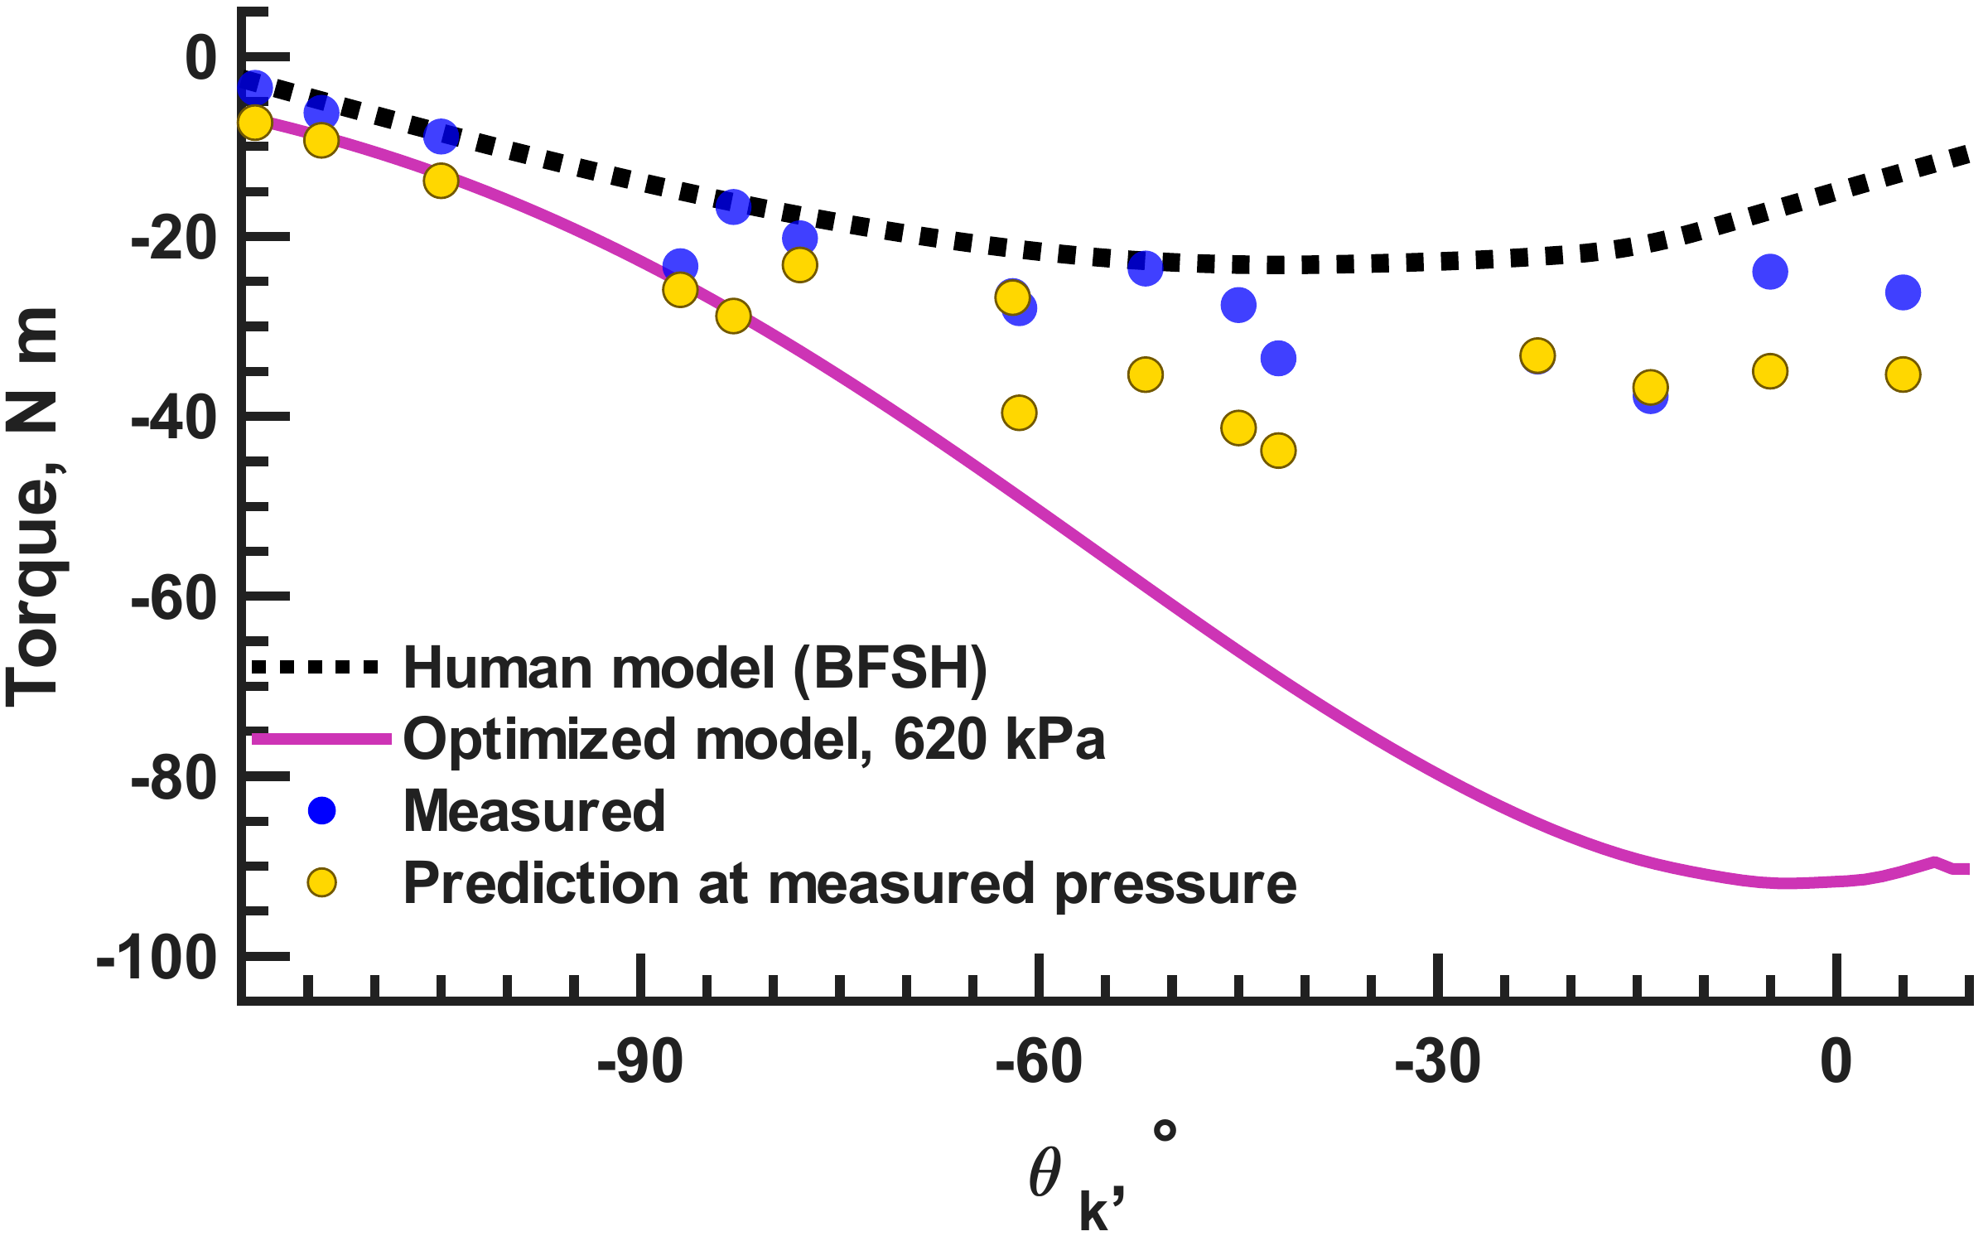
All fifteen flexor measurements meet the human target
15 of 15 targets met · 226.5–638 kPa · negative torque denotes flexion
Dissertation Ch. 4 · Current knee-torque manuscript, §§3–4
15
Notes:
The selected human target is maximum-isometric biceps femoris short head from OpenSim Gait2392. Flexion torque is negative, so compare magnitudes. All 15 holds meet or exceed it from −119 to +5 degrees. The source reduction gives margins +0.42 N m at −105 degrees to +17.0 N m at −14 degrees. Recorded pressures are 226.5–638 kPa. Physical lengths are 561/28 and 560/30 mm resting/tendon. Preserve the nominal 562 mm prediction label and distinguish prediction settings from these measurements. The full-pressure predicted curve and variable-pressure points are different conditions. Capacity is demonstrated while prediction agreement remains uneven.
Sources: Dissertation Ch. 4 · Current knee-torque manuscript, §§3–4
flexphysical

Slide 16
Measured capacity makes feedback design a meaningful next question
Mechanical foundation established | Next question
Resting-length-aware force prediction | Which sensory signals should regulate it?
Corrections for the joint transmission | Under what experimental conditions?
9 extensor + 15 flexor target comparisons | What pathway effect should be tested?
Mechanical capacity and sensory control answer different questions
Dissertation Ch. 4 · Current knee-torque manuscript, §§3–4
16
Notes:
The corrected model lowers held-out error, and the redesigned routes meet their selected human-muscle targets at all 24 measured points. This establishes tested isometric capacity, while pressure-specific prediction error remains. It does not tell us which feedback should recruit that capacity. To choose biologically motivated feedback, we need the source evidence, including preparation, pathway sign, and experimental task. That need motivates SADb.
Sources: Dissertation Ch. 4 · Current knee-torque manuscript, §§3–4

Slide 17
Sensory findings are distributed across experimental contexts
A modeling decision needs… | The record must retain…
A sensory signal | Receptor and measured quantity
A connection sign | Target pathway and experimental conditions
A task-dependent effect | Species, preparation, and behavioral phase
A defensible assumption | Source paper and translation notes
Dissertation Ch. 5; Appendix E
17
Notes:
The third gap is access to evidence. A pathway name alone does not tell a modeler what was measured, in which species or preparation, or whether an effect depends on task or phase. SADb preserves those links and makes them searchable. The application is a literature resource that supports a modeling decision; it is not a table of universal controller gains. The next slide shows how a researcher follows those links.
Sources: Dissertation Ch. 5; Appendix E

Slide 18
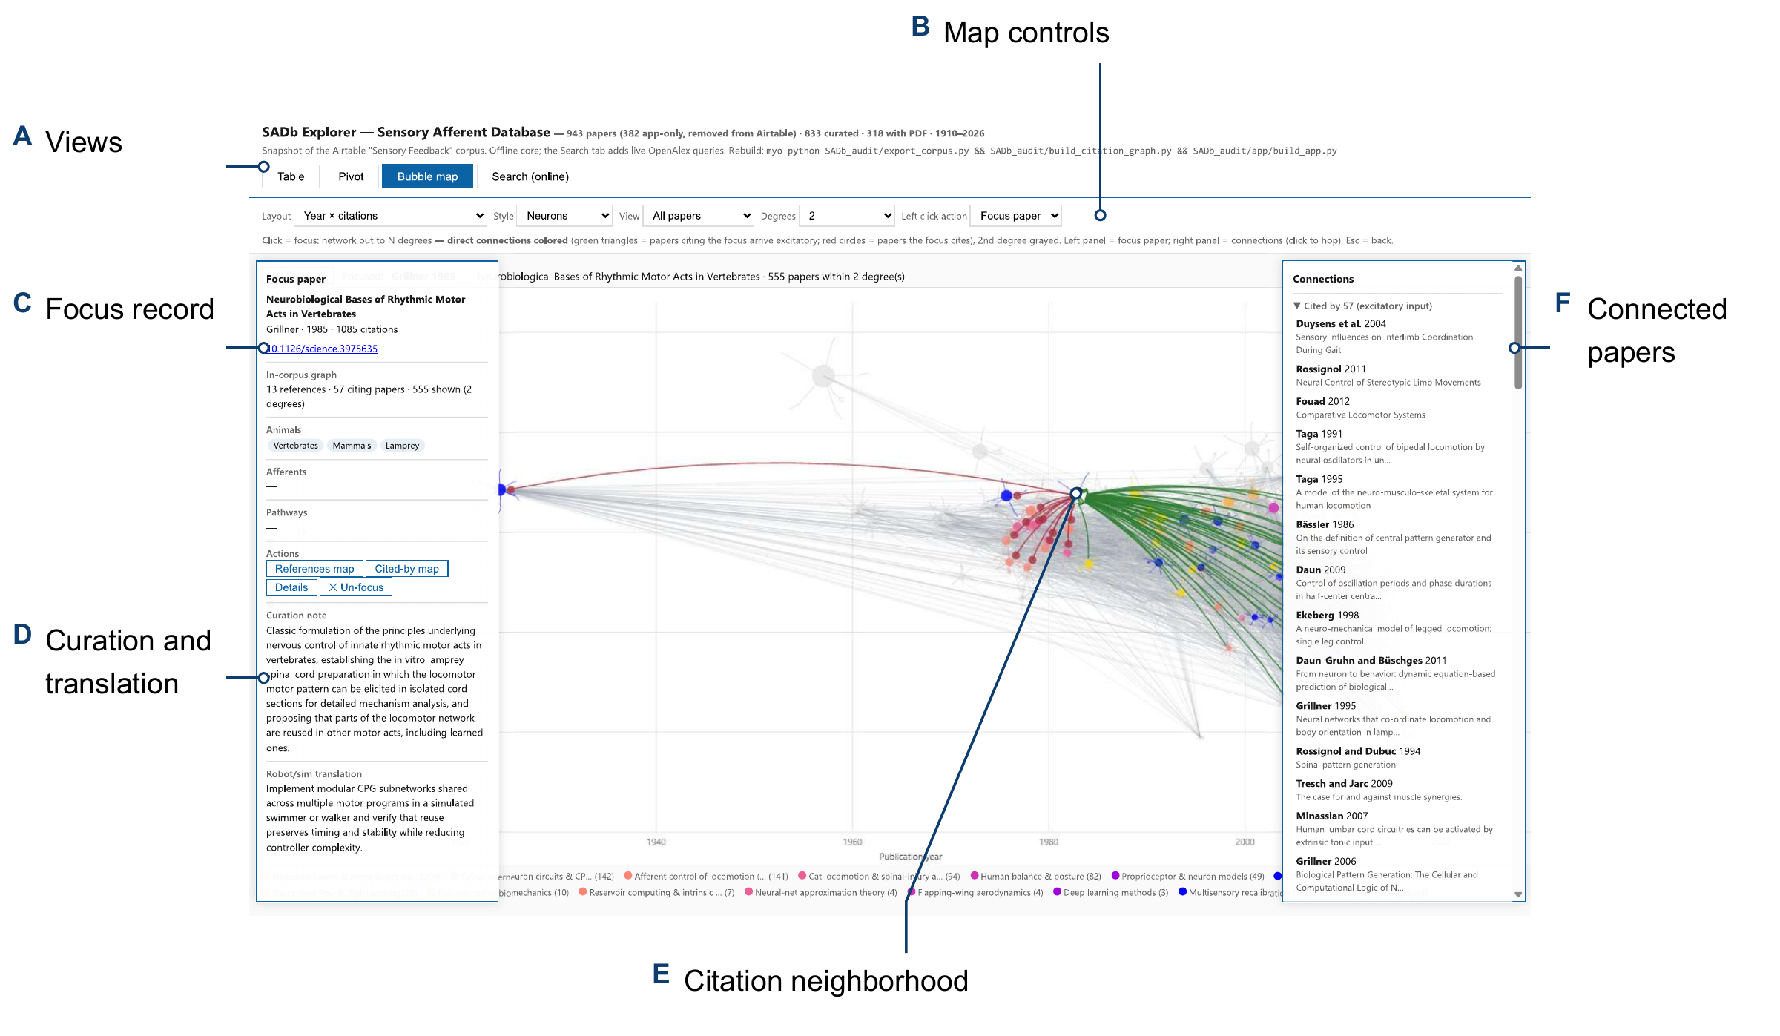
SADb makes sensory evidence traceable to its source context
1,393 total records · search, pivot, and follow citation links
Dissertation Ch. 5, The Resource · Appendix E, distributed app snapshot
18
Notes:
Use the six annotated callouts to explain the app: A view selection, B map controls, C focus record, D curation and translation, E citation neighborhood, and F connected papers. Search and filter across 1,393 total app records, including 943 in the Papers category. Models and reviews can also be publications, so the category count is not a total publication count. Table search spans record types; pivots and citation views use paper records. Embedded data support offline exploration; the online-search tab requires a network. A static screenshot shows functionality, not retrieval accuracy.
Sources: Dissertation Ch. 5, The Resource · Appendix E, distributed app snapshot
sadb

Slide 19
Source context turns a candidate pathway into a testable assumption
Source finding
Explicit circuit choice
Controlled test
Signal and experimental context
Connection sign, target,
and selected parameters
Matched input or
pathway intervention
A source-grounded pathway still needs implementation and functional checks
Dissertation Ch. 5, Use in Neural-Controller Design; Ch. 6
19
Notes:
For an example, a spindle pathway suggests length and velocity signals, an excitatory homonymous connection, and reciprocal inhibition. The source conditions must remain attached to that choice; gains and receptor dynamics still require explicit selection. This closes the evidence-access gap but opens an implementation question: does the circuit produce the expected effect when coupled to this mechanical model? That is the purpose of the SNS tools section.
Sources: Dissertation Ch. 5, Use in Neural-Controller Design; Ch. 6

Slide 20

The walker attempts exposed a need for interpretable model tests
A circuit can oscillate while
its mechanical model fails
Implementation, feedback, and
mechanics must be separated
Question 4: what caused the observed neural–mechanical behavior?
Dissertation Ch. 6, opening narrative and tools gap
20
Notes:
The Li–Deng/W2L work combines published mechanics and a layered neural controller. Suspended motion did not automatically transfer to supported or weight-bearing behavior, and the MATLAB/Simulink implementation raised additional questions about implementation and coupling. A failed or rhythmic trajectory alone could not identify the cause. I therefore developed a workflow for checking the circuit, connecting actuators and sensors, tuning in stages, and changing one condition at a time. The demonstrations that follow answer distinct questions within that workflow.
Sources: Dissertation Ch. 6, opening narrative and tools gap
robot

Slide 21
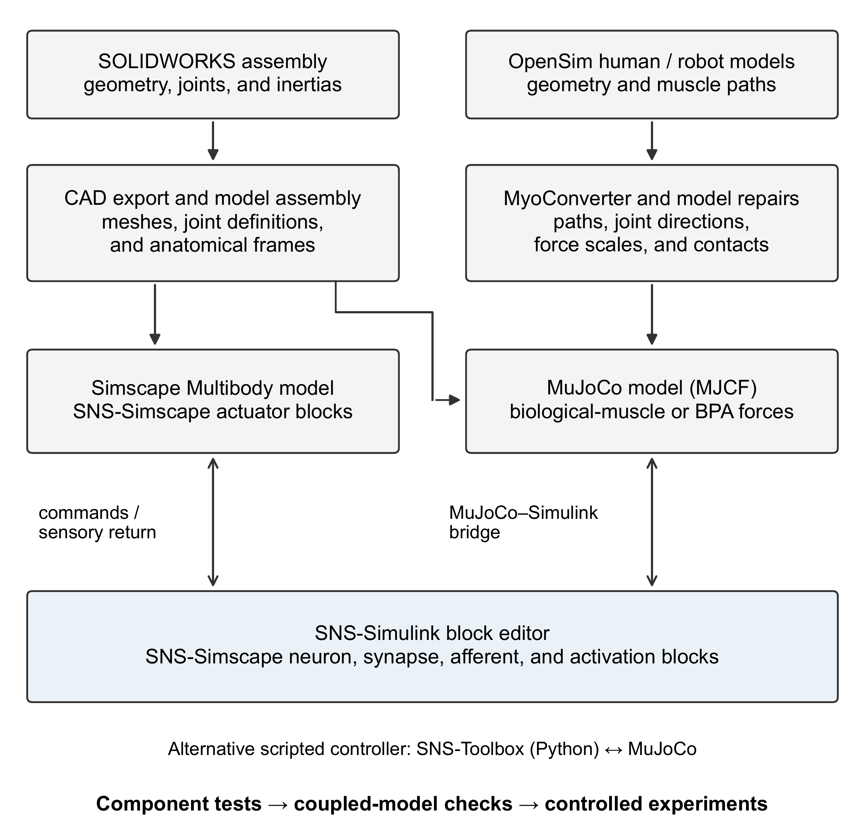
The model workflow supports distinct mechanical implementations
Command exchange, circuit agreement, and motion each require their own check
Dissertation Ch. 6, Model construction and neural-controller interfaces
21
Notes:
The source schematic separates CAD/Simscape imports from OpenSim/MyoConverter/MuJoCo conversion and repairs. Neural control uses graphical SNS blocks or scripted SNS-Toolbox. The MathWorks bridge provides a command/sensor interface, not evidence that every circuit transfers dynamically. My contribution is the neural/actuator coupling, graphical implementations, and verification procedures, building on existing engines and formulations.
Sources: Dissertation Ch. 6, Model construction and neural-controller interfaces
workflow

Slide 22
Staged tests separate rhythm, feedback, and mechanical support
Condition introduced | Question tested
Suspended, without sensory feedback | Can the circuit generate activity?
Sensory feedback | How does feedback reshape the output?
Standing and perturbations | Can the model maintain posture?
Supported ground contact | Does physical coordination meet the criterion?
Reference and intervention comparisons | Which mechanism or mismatch explains the result?
Dissertation Ch. 6, curriculum Table 6.2
22
Notes:
The staged curriculum is a method for locating the next failure, not a claim that every model passes every stage. Start suspended without feedback, add feedback, introduce standing and perturbations, and then assess supported ground coordination against a reference. Saved controllers and controlled removals make conditions comparable. The next demonstrations test corrective feedback, separation of timing and motor output, and mechanical coordination.
Sources: Dissertation Ch. 6, curriculum Table 6.2

Slide 23
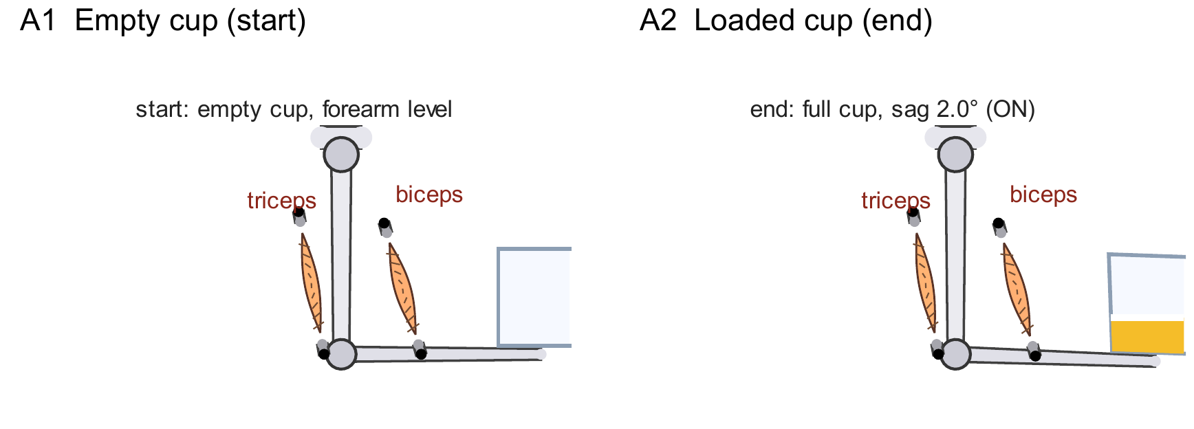
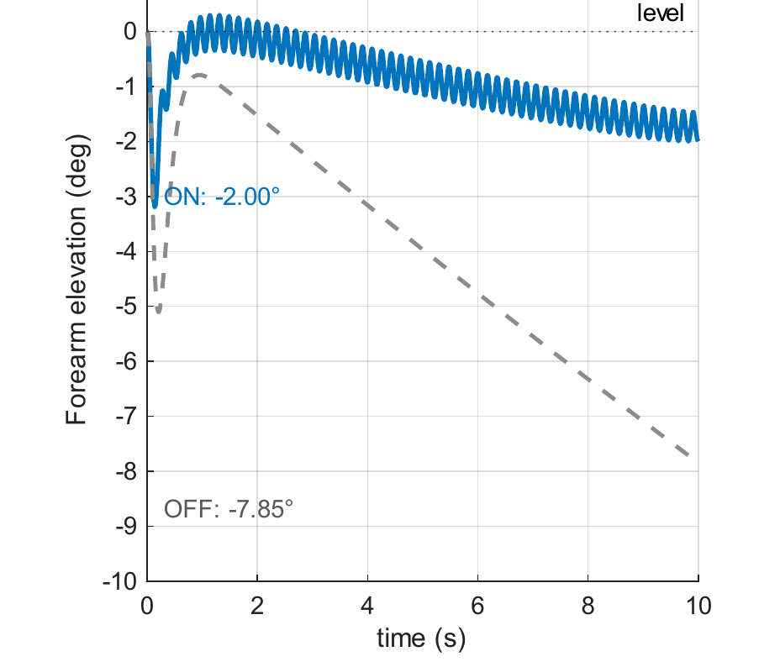
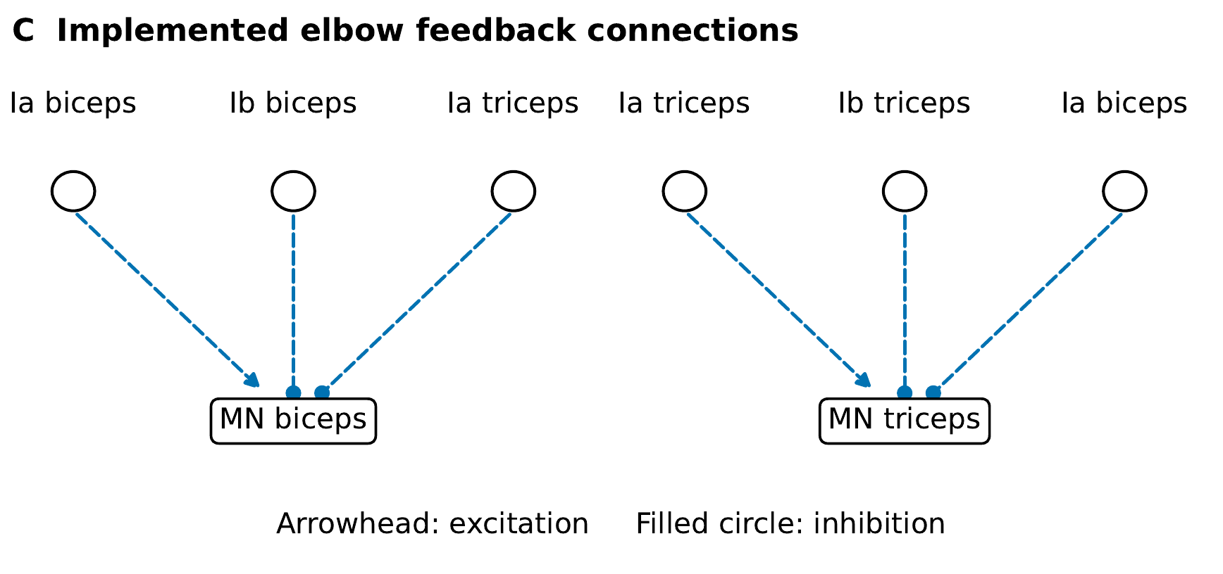
Sensory feedback reduces sag in the loaded-arm model
B Feedback on/off
Sag: 2.00° with feedback · 7.85° without feedback
Dissertation Ch. 6 and Appendix D · Current saved verification records
23
Notes:
A1 and A2 show the empty and loaded container. B compares forearm elevation with feedback on and off. Sag is 2.00 degrees with feedback versus 7.85 degrees without. C shows the actual implemented circuit: biceps Ia excites biceps MN and inhibits triceps MN; triceps Ia does the converse. Own-muscle Ib inhibits its MN. Arrowheads mean excitation, and filled circles inhibition. This demonstrates a corrective effect in the reduced block model under the selected settings.
Sources: Dissertation Ch. 6 and Appendix D · Current saved verification records
arm_pose
arm_circuit
arm_trace

Slide 24
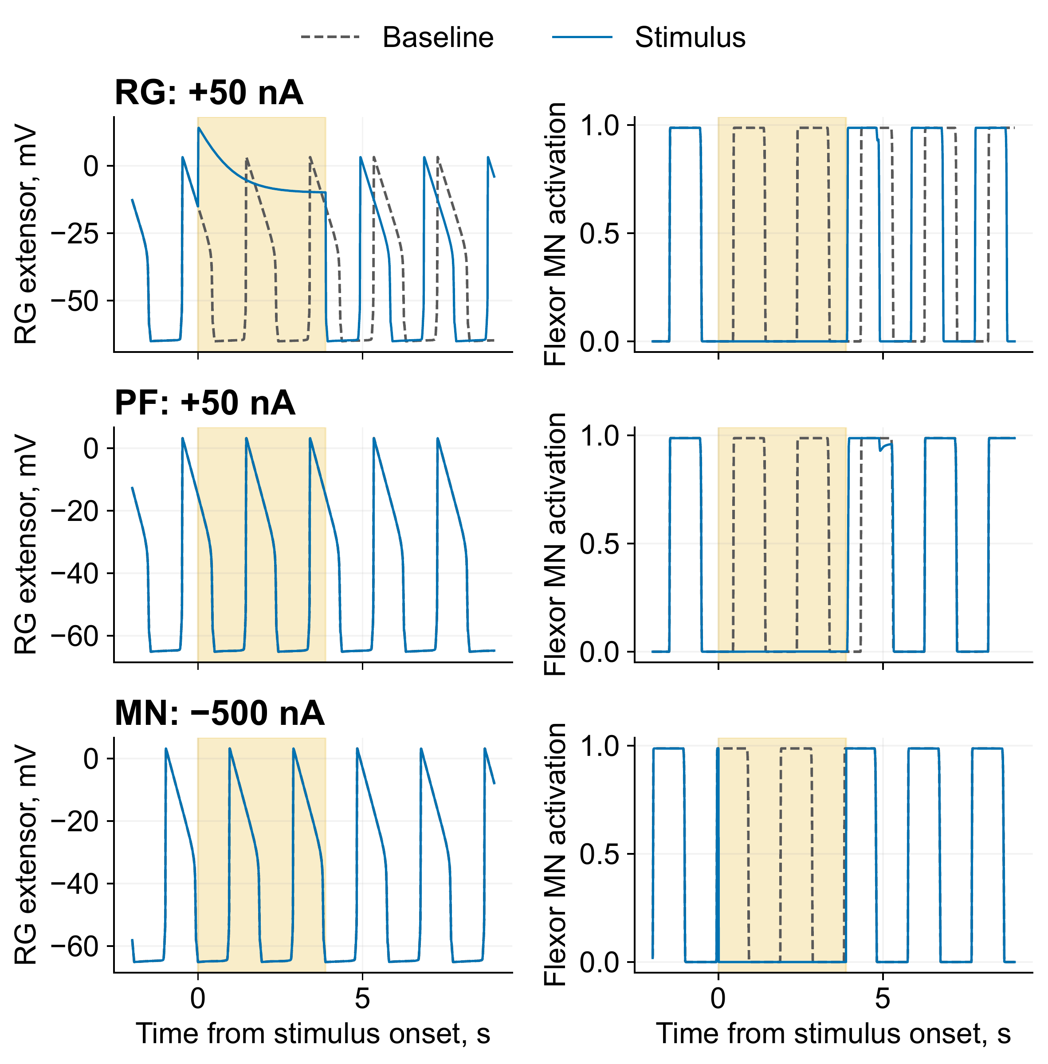
Two deleted bursts can preserve or reset the rhythm
Stimulated layer | RG shift, cycles
RG | 0.211
PF | 0.000
MN | 0.000
RG: rhythm generator
PF: pattern formation
MN: motor neuron
Reduced Deng-derived circuit · two baseline periods · suspended model
Dissertation Ch. 6 and Appendix D · Current saved verification records
24
Notes:
The reduced Deng-derived translated circuit is coupled to a suspended model. Stimuli lasting two baseline periods suppress two expected flexor motor bursts at each tested layer. RG-extensor +50 nA shifts both RG and motor timing by 0.211 cycle. PF-extensor +50 nA suppresses output without resetting the RG clock, and flexor-MN −500 nA also gives a non-resetting deletion. Read left RG traces and right MN activation together. Stronger-current controls matter: a one-second PF pulse shifts motor timing by 0.208 cycle while RG timing stays unchanged. A motor shift alone therefore does not prove RG resetting. This is a translated reduced-circuit test, not original-rat locomotion replication.
Sources: Dissertation Ch. 6 and Appendix D · Current saved verification records
layers

Slide 25
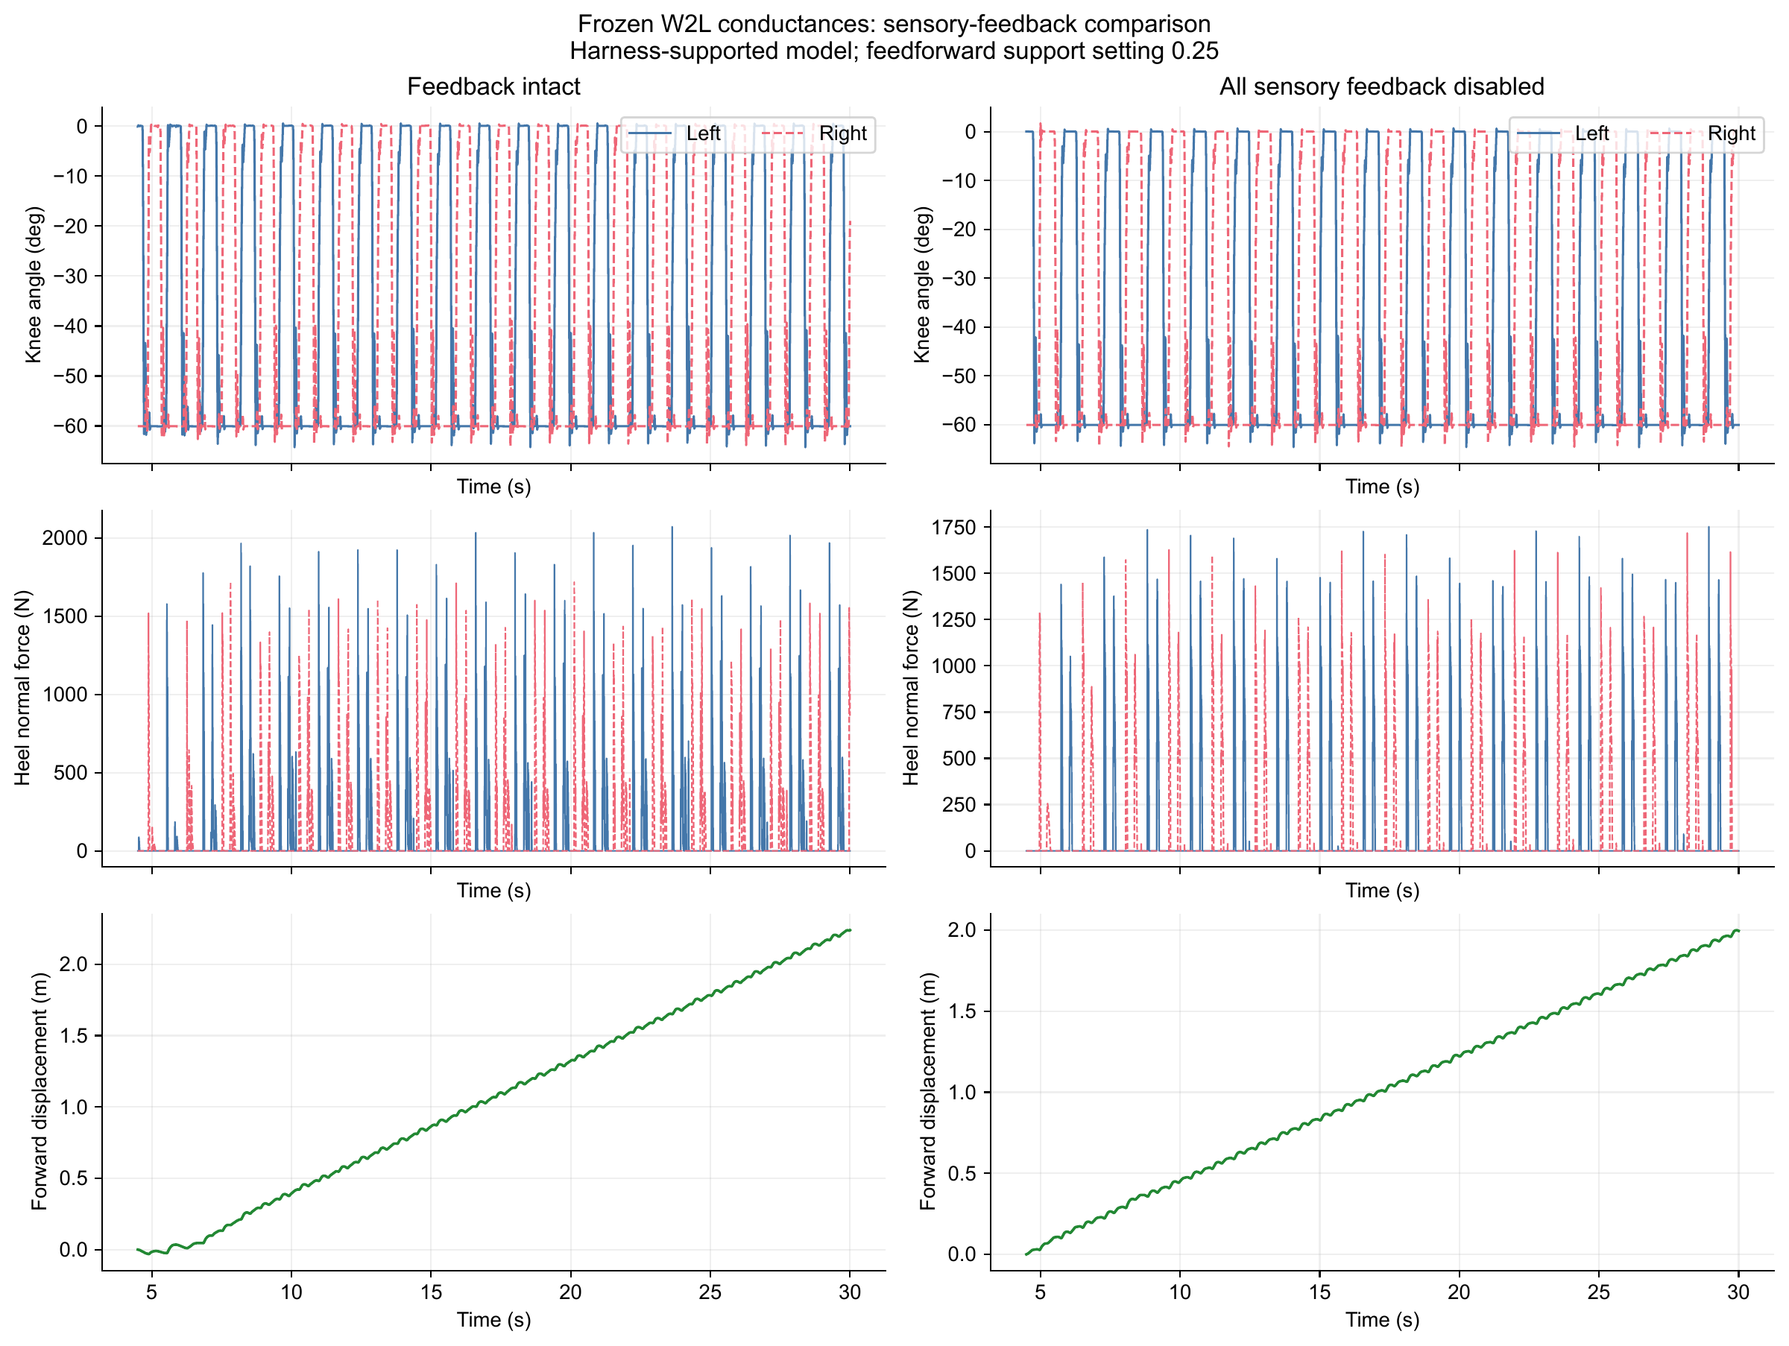
Feedback coordinates foot loading in the W2L model
Median bilateral contact phase: 0.498 intact · 0.223 without feedback
Dissertation Ch. 6 and Appendix D · Current saved verification records
25
Notes:
This recovered W2L comparison fixes effective conductances, drive, and support settings, then disables all sensory feedback. Median contact phase changes from 0.498 to 0.223 cycles. The accepted supported-stepping interval is 0.35–0.65, with 0.5 indicating alternation. Forward motion and joint cycling persist after deletion. Over 4.5–30 s, displacement is 2.239 m with feedback and 1.996 m without. The demonstrated contribution is contact coordination. Do not confuse this paired protocol with the separately supported basin/replay tests.
Sources: Dissertation Ch. 6 and Appendix D · Current saved verification records
w2l

Slide 26
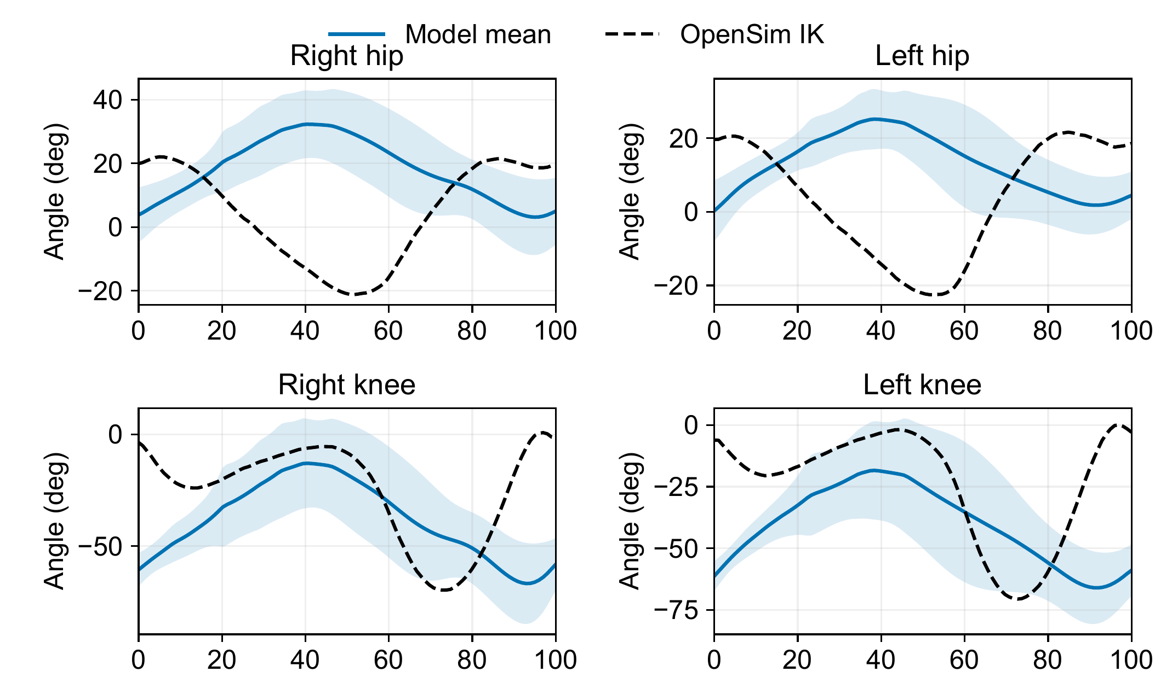
Rhythmic Gait2392 cycles retain hip and knee errors
Hip timing differs
Knee timing differs
No fitted phase shift
or amplitude scaling
Gait cycle, %
10 cycles per leg · stance fractions 0.71 / 0.65 versus reference 0.61
Dissertation Ch. 6 and Appendix D · Current saved verification records
26
Notes:
The supported human-model replay contains ten detected cycles per leg. This crop shows hip and knee mean and one standard deviation against the Gait2392 inverse-kinematics reference. Each leg aligns to its own loading onset with no fitted phase shift, angle offset, or amplitude adjustment. Hip and knee timing differences remain visible. Model stance fractions are 0.71 right and 0.65 left versus reference 0.61. Separate leg alignment does not prove bilateral coordination. The complete ankle/contact overlay is backup slide 34. Rhythmic cycles alone do not establish normal human gait.
Sources: Dissertation Ch. 6 and Appendix D · Current saved verification records
ik_hipknee

Slide 27

Extra abductor control prevents crossing in the AH001 test
15–40 s | Off | On
Crossed states | 67% | 0%
Min. spacing | −38.3 mm | 142.4 mm
54 reference-tension actuators; 80% vertical + lateral/angular assistance
MN clamp cancels PF/reflex currents; regular stepping unverified
Dissertation Ch. 6 and Appendix D · Current saved verification records
27
Notes:
Anterior and oblique views show the same saved state. Matched 15–40 s runs compare the separation-control bundle off and on. Reversed ankle ordering changes from 67% to zero, and minimum separation from −38.3 to 142.4 mm. The bundle adds separation feedback and raises the currently abducting-route activation floor from 5% to 6%. The current model has 54 reference-tension actuators and 262 neurons/230 inputs. The hybrid MN clamp cancels incoming PF/reflex currents, so it does not establish effective PF/reflex control of activation. Regular stepping is not accepted. Use the GIF as an optional replay, with support and geometry assumptions on the next slide.
Sources: Dissertation Ch. 6 and Appendix D · Current saved verification records
ah001

Slide 28
These contributions enable better-defined research experiments
Contribution | Research enabled
BPA force model | Compare actuator lengths before building a route
Joint design factors and physical tests | Test transmission choices against torque requirements
SADb | Select feedback hypotheses with source context
SNS tools and controlled demonstrations | Distinguish neural, sensory, and mechanical effects
Dissertation Introduction, Discussion, and Conclusion
28
Notes:
Return to our research goals. The force model supports actuator choice; joint factors support interpreting the transmission; SADb supports selecting a sensory hypothesis; and the SNS tools support controlled interventions. A researcher can now separate a force-capacity question from a pathway-sign question or a model-coupling fault. This is how the contributions advance the robot as an experimental instrument, while autonomous behavior remains an integration goal.
Sources: Dissertation Introduction, Discussion, and Conclusion

Slide 29
Future experiments can connect these foundations to the research goals
Research goal | Next experiments
Autonomy in unstructured environments | Dynamic loading, perturbations, and graded support reduction
Understanding biological mechanisms | Matched neural-pathway and mechanical interventions
Prosthetic and orthotic translation | Task-specific assistive concepts and later human validation
Greater biomimetic detail is useful when it enables a more decisive test
Dissertation Discussion; current model limitations
29
Notes:
Organize future work by the original goals rather than by a software to-do list. For autonomous robots, test dynamic actuator/transmission behavior, effective neural control, and progressive support reduction under explicit gait criteria. For biological understanding, compare controlled pathway and mechanical changes with experimental response signatures. Prosthetic and orthotic studies are a later translation requiring task-specific and human validation. The immediate work is to establish the validity and interpretation of each experiment.
Sources: Dissertation Discussion; current model limitations

Slide 30
The dissertation makes key biomimetic design assumptions testable
Actuator choice grounded in measured force
Joint designs tested against selected human targets
Sensory hypotheses made explicit and experimentally testable
Thank you · Questions
Ben P. Bolen · Portland State University · AARL
30
Notes:
Conclude the argument. Our long-term goals are capable autonomous robots and biological insight, with assistive devices as a further application. This dissertation supplies resting-length-aware force prediction, corrected and physically tested knee routes, source-linked sensory evidence, and tools for controlled neuromechanical experiments. All nine extensor and fifteen flexor measurements meet the selected human-muscle targets. These foundations enable stronger experiments; they do not by themselves establish an autonomous walking humanoid. Thank the advisor, committee, AARL, and collaborators, then invite questions.
Sources: Ben P. Bolen · Portland State University · AARL

Slide 31
At 112 mm, the new model reduces force error to 4.5%
10 mm BPA · 112 mm resting length · 620 kPa
Bolen et al. (2026), Actuators 15(5):230 · Dissertation Ch. 3
31
Notes:
This is the 10 mm BPA at 112 mm resting length and 620 kPa. Measured force is 350.9 N, the model gives 335.3 N, and the manufacturer tool gives 498.6 N. Reported errors are 4.5% and 42.1%. This is one reported case, not the average error or an independent length holdout. The native chart uses the published values directly.
Sources: Bolen et al. (2026), Actuators 15(5):230 · Dissertation Ch. 3

Slide 32

The cam model predicts headroom above the required target
+30.83% above required envelope · 269–507 kPa predicted pressure
Dissertation Ch. 4 · Current knee-torque manuscript, §§3–4
32
Notes:
The adopted cam design predicts a minimum margin of 30.83% over the required envelope, which itself includes 5% overshoot above the selected human reference. The minimum margin over the plain human target is 39.77%. Predicted pressure needed for the required envelope is 269–507 kPa. The blue curve is the 620 kPa model prediction. These margins are predictions, not physical measurement margins.
Sources: Dissertation Ch. 4 · Current knee-torque manuscript, §§3–4
camtorque

Slide 33

Matched rhythm cores reproduce the same driven bursts
1.000 s period · 10 expected bursts · correlation ≥ 0.99996
Dissertation Ch. 6 and Appendix D · Current saved verification records
33
Notes:
This comparison uses the driven W2L rhythm core, with matched connectivity, initial states, and phasic heel-contact input. Periods match at 1.000 s, all ten expected bursts occur, and trace correlation is at least 0.99996. A 2 ms lag equals one solver step. Removing the specified phasic inputs latches both implementations. This is agreement under a defined protocol, not full-network equivalence. The bridge additionally gives bit-exact scored sensor readback, but a separate tonic-drive full circuit settles in Simulink while its NumPy reference oscillates.
Sources: Dissertation Ch. 6 and Appendix D · Current saved verification records
rhythm

Slide 34
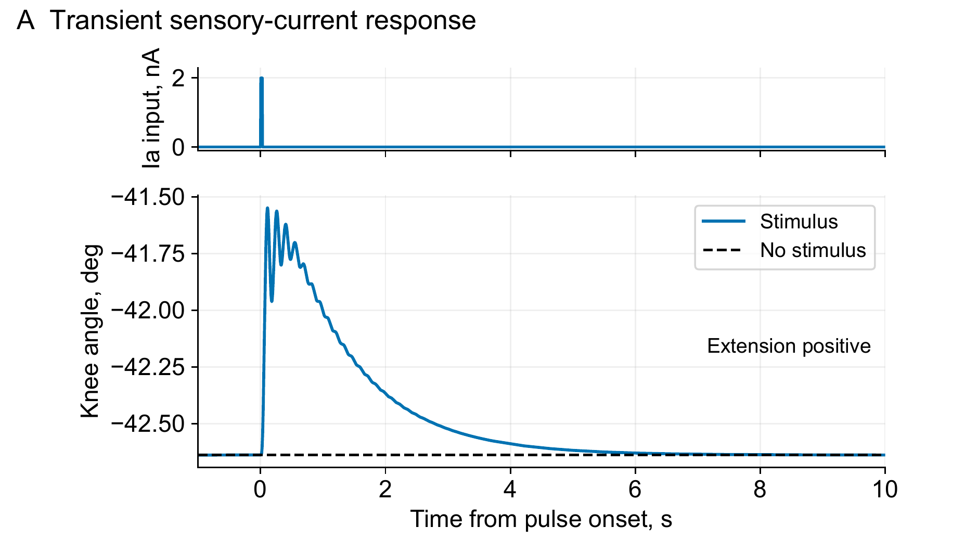
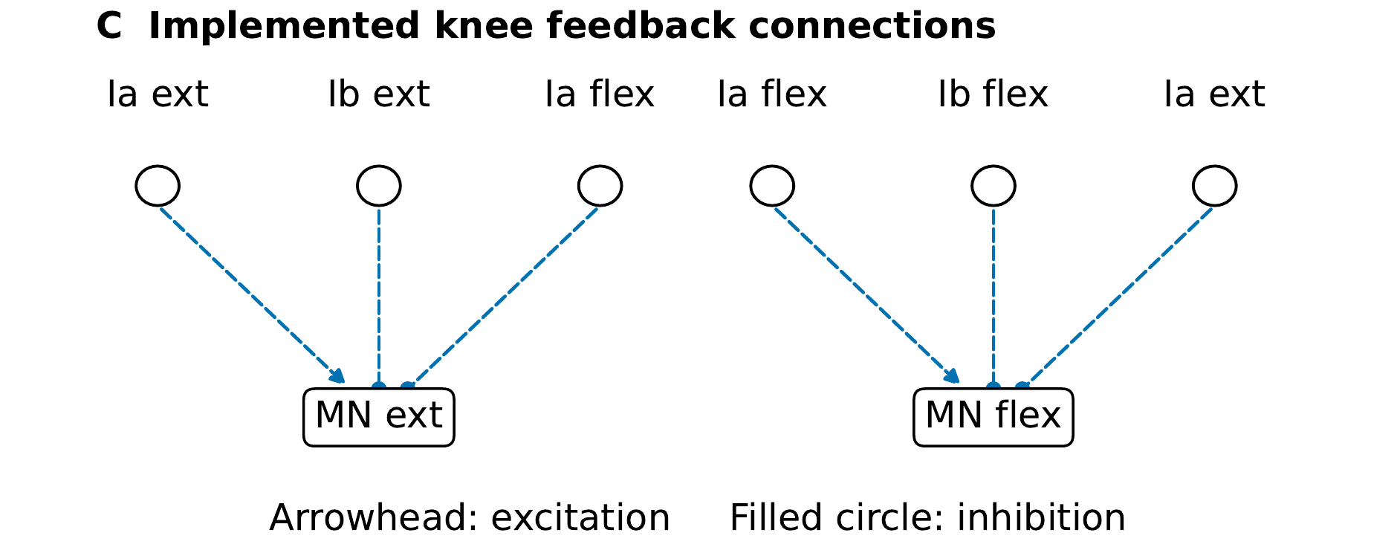
The knee model produces a transient sensory response
2 nA for 30 ms
1.09° at 111 ms
Recovery at 6.355 s
Six neural saturation widths changed in this configuration
Dissertation Ch. 6 and Appendix D · Current saved verification records
34
Notes:
A matched no-stimulus run isolates the effect of a 2 nA, 30 ms current pulse at the extensor Ia input after settling. The peak extension excursion is 1.09 degrees at 111 ms, and the stated recovery thresholds are met at 6.355 s. Six MN/Ia synaptic saturation widths were broadened; the original narrow ramps sustained oscillations. C shows the six feedback connections. These are engineered block settings, not a calibrated human tendon-tap reflex.
Sources: Dissertation Ch. 6 and Appendix D · Current saved verification records
knee_trace
knee_circuit

Slide 35
The evidence establishes specific capabilities within clear limits
Evidence level | What the result establishes | Remaining boundary
Measured hardware | Isometric torque capacity | Dynamic response and transfer
Neural demonstrations | Specified response and intervention effect | Circuit- and protocol-specific
Supported W2L / human models | Coupling and coordination tests | External support remains
AH001 integration | Hybrid allocation; PF/reflex currents cancelled | 80% vertical + lateral/angular support
AH001: reference tensions, MN clamp, provisional feet, and ideal brackets
No harness-free walking has been demonstrated
Current manuscript Ch. 6 / Appendix D · Session 1 AH001 records
35
Notes:
Concentrate model scope here. W2L and human-model evaluations retain mechanical support. No harness-free walking is established anywhere in the program. For AH001 the displayed interval uses 80% actual vertical assistance plus lateral and angular support. Actuators are reference tensions, not calibrated BPA dynamics. The MN clamp cancels incoming PF and reflex currents. Foot mounting is provisional, with ideal rigid attachment brackets and assumed passive knee stops. Preventing crossing does not establish regular stepping, balance, or hardware validity. Keep these distinctions without repeating the limitation on every slide.
Sources: Current manuscript Ch. 6 / Appendix D · Session 1 AH001 records

Slide 36
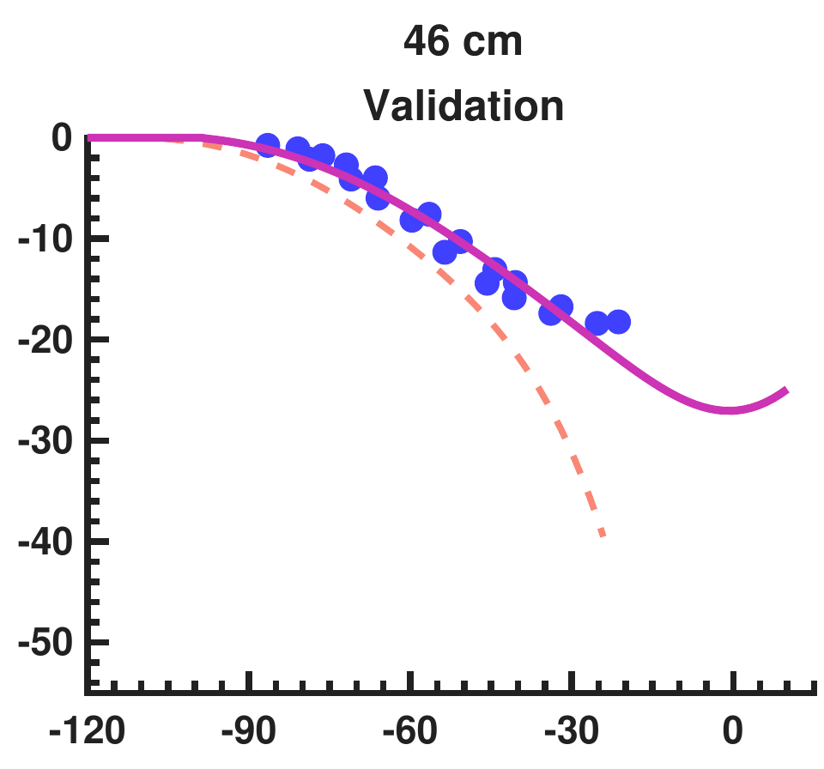
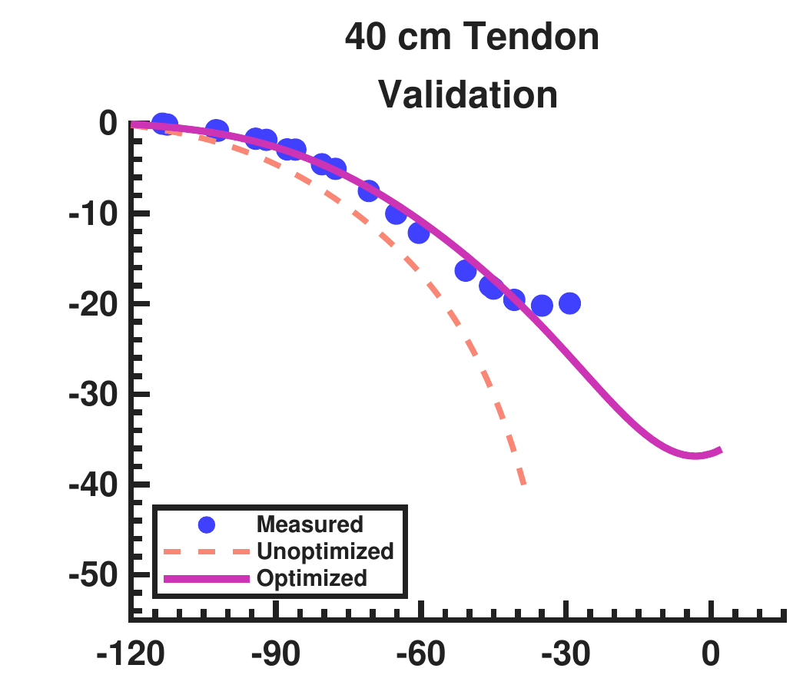
The held-out flexor traces show the corrected torque trend
Torque, N m
(C)
(D)
Knee angle, deg
Held-out mean RMSE: 7.588 to 1.490 N m
Dissertation Ch. 4 · Current knee-torque manuscript, §§3–4
36
Notes:
Panels C and D are the held-out nominal 46 cm and 40 cm-tendon tests, corresponding to actual 45.7 and 40.6 cm. Separate crops retain the full traces and shared legend; native labels supply panel letters and axes. The full model shares effective stiffness across both knee configurations. Validation mean RMSE is 1.490 N m.
Sources: Dissertation Ch. 4 · Current knee-torque manuscript, §§3–4
validation_left
validation_right

Slide 37
The adopted identification reserves tests in each configuration
Configuration | Training | Held out | Not used
Pinned flexor | 2 | 2 | 1
Pinned extensor | 3 | 3 | 3
Shared effective stiffness pair: χ₁ = 39.98, χ₂ = 14.73 kN/m
Dissertation Ch. 4 · Current knee-torque manuscript, §§3–4
37
Notes:
Use the exact adopted-fold test split. Flexor training is 48.5 and 41.0 cm; validation is 45.7 and 40.6 cm-tendon; 47 cm was not used. Extensor training is 43.6, 43.2-tendon, and 45.7 cm; validation is 40.0, 40.0-tendon, and 46.5 cm. The early shifted-bracket tests were excluded. Identification uses gamultiobj; route redesign uses surrogateopt and patternsearch. χ1/χ2 are effective stiffness terms, not isolated bracket material values.
Sources: Dissertation Ch. 4 · Current knee-torque manuscript, §§3–4

Slide 38
Physical dimensions differ from prediction settings
Actuator | Resting length, mm | Tendon length, mm
Flexor 1 | 561 | 28
Flexor 2 | 560 | 30
Extensor 1 | 828 | 92
Extensor 2 | 826 | 85
Prediction inputs: flexor 561.49 / 5.00 mm; extensor 827.74 / ≈92.49 mm
Torque manuscript, Physical Tests · Dissertation Appendix C dimensions
38
Notes:
The rows are physical measurements, in resting/tendon order. Flexor 1 is 561/28 mm, flexor 2 560/30 mm, extensor 1 828/92 mm, and extensor 2 826/85 mm. Prediction inputs instead use shared flexor resting length 561.49 mm and an effective 5.00 mm tendon parameter after fitting adjustment, and extensor resting length 827.74 mm with about 92.49 mm tendon. The nominal 562 mm plot label remains a nominal prediction label.
Sources: Torque manuscript, Physical Tests · Dissertation Appendix C dimensions

Slide 39
Stimulation duration changes the deletion interpretation
Protocol | RG shift, cycles | Motor shift, cycles
RG, two periods | 0.211 | 0.211
PF, two periods | 0.000 | 0.000
MN, two periods | 0.000 | 0.000
PF, one second | 0.000 | 0.208
stimulus_results_all.csv · Current Appendix D layer-stimulus protocols
39
Notes:
All values are from the saved table. Two-period RG stimulus: +50 nA for 3.876 s, +0.210526 cycle RG and MN shift. PF same current/duration: zero residual phase at both. MN inhibition: −500 nA for 3.876 s, zero residual. The one-second PF control gives +0.208462 motor shift with zero RG shift. Thus motor phase shift alone does not establish an RG reset. The smaller-current sweep has no observable complete-burst deletion, although brief active-time losses appear in some rows.
Sources: stimulus_results_all.csv · Current Appendix D layer-stimulus protocols

Slide 40
AH001 separation control changes a matched diagnostic
15–40 s measure | Control off | Control on
Reversed ankle ordering | 67% | 0%
Minimum separation | −38.3 mm | 142.4 mm
Right TFL mean activation | 22.3% | 81.8%
Vertical assistance | 80% BW | 80% BW
Sampled opposite-leg penetration | 2.700 mm | 0 mm
AH001_20261028/PLACEMENT_RECOMMENDATION.md · asset_provenance.json
40
Notes:
Both runs use matching geometry, support, initial pose, and reference tensions. The control bundle adds 160 N/m separation feedback capped at 20 N, plus a 5% to 6% floor on currently abducting routes. The interval is 15–40 s. Zero reversed ordering and zero sampled mesh penetration are separate checks. Toe-out remains about 25–28 degrees, and post-ramp knee motion is small. Exact-fast and reference saved arrays reproduce bit for bit in fresh 40 s runs. This is numerical replay, not robustness or hardware validity.
Sources: AH001_20261028/PLACEMENT_RECOMMENDATION.md · asset_provenance.json

Slide 41

Reported force comparisons favor the model in the shown cases
Measured-versus-predicted force at the two displayed actuator lengths
Bolen et al. (2026), Actuators 15(5):230 · Dissertation Ch. 3
41
Notes:
The selected 10 mm comparisons are the two upper panels of the published figure, with measured force on x and predicted force on y. The diagonal indicates agreement. Preserve model identities and tested length scopes. This supports the comparison in these reported cases and is not an exhaustive model benchmark. The published coefficients and scientific results remain unchanged.
Sources: Bolen et al. (2026), Actuators 15(5):230 · Dissertation Ch. 3
comparison

Slide 42
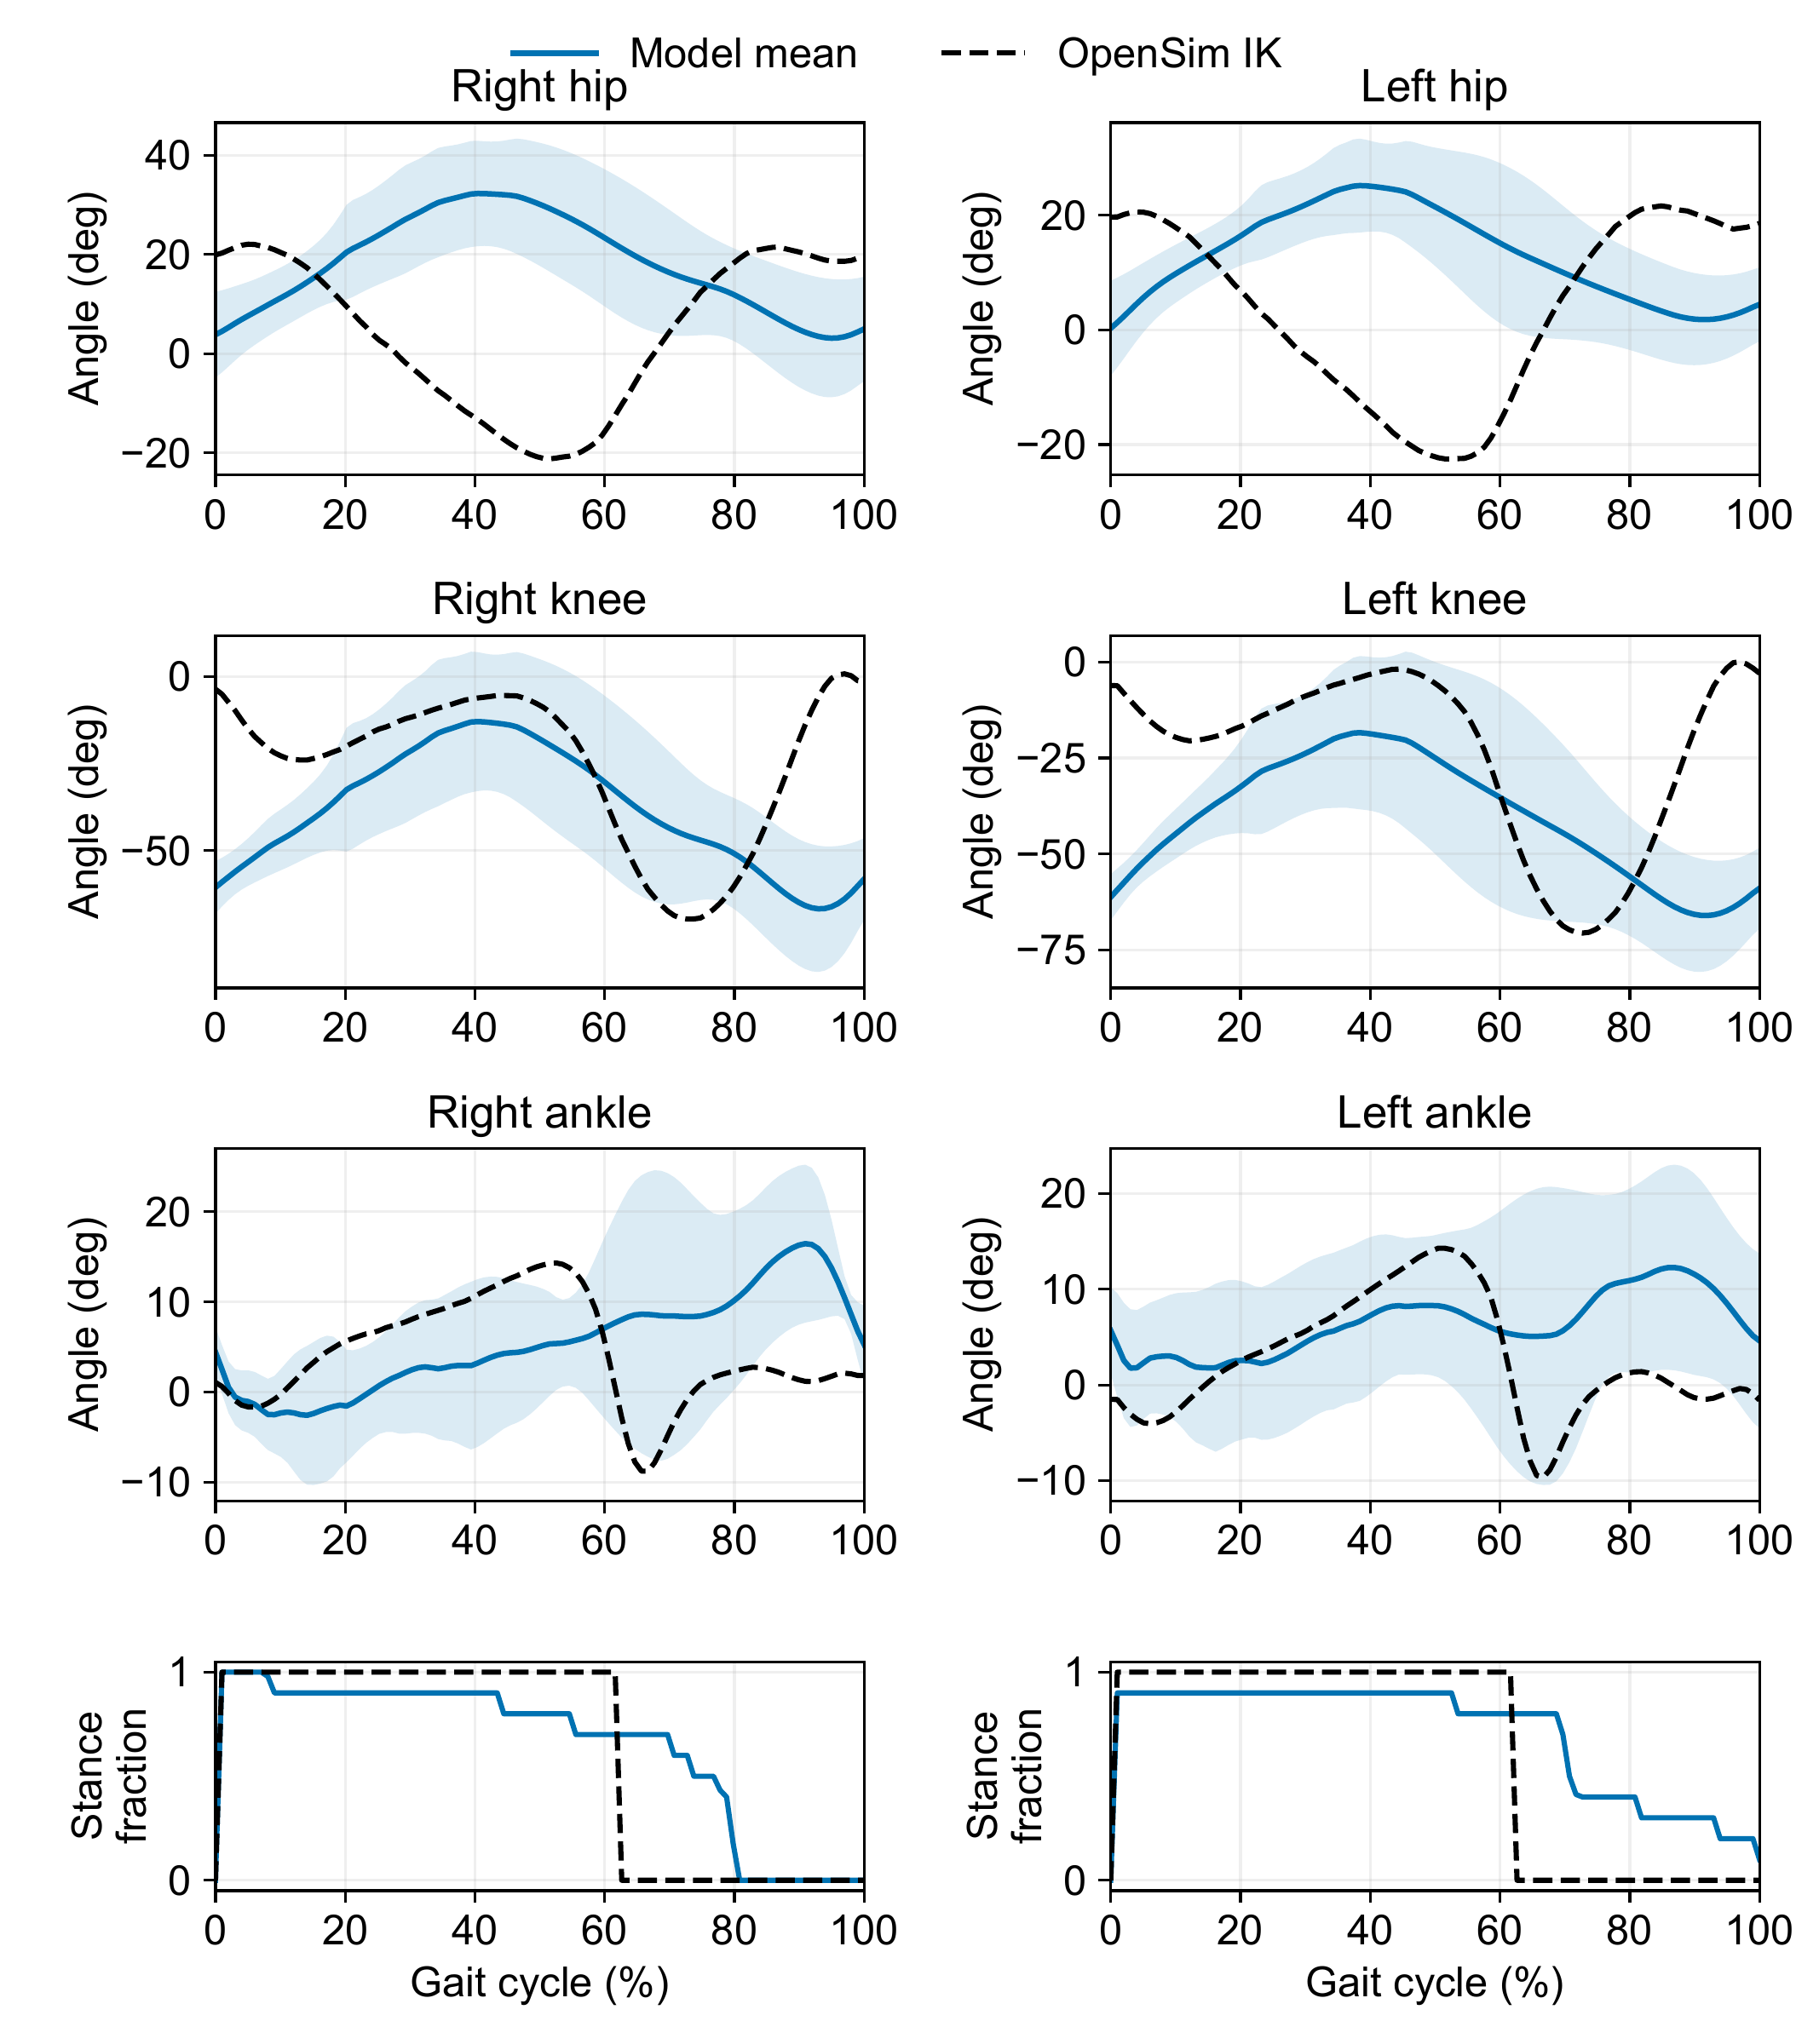
The complete IK overlay also exposes contact differences
Model mean and standard deviation · OpenSim IK reference
Dissertation Ch. 6 and Appendix D · Current saved verification records
42
Notes:
This complete source figure includes hip, knee, ankle, and stance/contact comparisons. Each leg is aligned independently to loading onset. The same ten-cycle replay supplies the core-talk crop. No fitted angle offsets, amplitude adjustment, or phase shifts are used. The model and reference stance fractions differ, and separate leg alignment does not establish bilateral phase.
Sources: Dissertation Ch. 6 and Appendix D · Current saved verification records
ik

Slide 43

The saved AH001 replay shows supported hybrid motion
Optional 12-second replay · same supported-control diagnostic
AH001_20261028/asset_provenance.json · saved 20–32 s interval
43
Notes:
Optional 12-second replay of the same supported AH001 abductor-control condition. The GIF contains 96 frames over 20–32 s. It illustrates the recorded kinematics and leg separation, not accepted regular stepping. Use slide 23 for support, actuator, and MN-clamp scope, and slide 31 for the matched measures.
Sources: AH001_20261028/asset_provenance.json · saved 20–32 s interval

